Slide 1


BSc Hons Computer Games Design and Development GDV4000 Introduction to Games Industry Practice
Game Design and Mechanics – Game Genres

Slide 2
The Plan:
A History of Genres in Games
Design Considerations
Where have I seen that before?
Anatomy of a Puzzle
Puzzle Games vs Puzzles IN games
Types of Puzzle Games
Examples and notable firsts
Props Revisited
Randomisation

Slide 3
A History of Genres in Games
In 1981 the US publication Computer Gaming World initially had just three headings for game genres:
Arcade
Wargame
Adventure
Writing in The Art of Game Design (1982), Chris Crawford used a classification system based more on the player experience and activities. He did also note that game design was moving incredibly quickly, and that any attempt at classification would be rendered obsolete in a very short time.
Skills-and-Action Games | Strategy Games
Combat Games | Adventures
Maze Games | D&D Games
Sports Games | Wargames
Paddle Games | Games of Chance
Race Games | Educational and Children’s Games
Miscellaneous Games | Interpersonal Games

Slide 4
A History of Genres
Why have different genres?
Some tie-in to other media forms such as TV, film, and books:
Horror
Sport
Action-Adventure
Others are more based on the Ludology (Game Mechanics):
Platform
Puzzle
First-Person Shooter
In 1985 Nintendo released the Famicom (NES in North America). To try to avoid a repeat of the crash that happened in 1983, they introduced an approval system to prevent a flood of unauthorised games, which was supported by a classification system of eight genres:
Adventure, Action, Arcade, Sports, Light-Gun, Programmable, Robot, Educational.
Other console manufacturers followed suit by implementing an approval system. Game Developers tended to stick to tried and tested formulas in order to get approval, which in turn led to the growth of the different genres (Adams, 2009). The growth in genres led to retailers displaying the games in a similar way on the shelves.

Slide 5
A History of Genres
Is it helpful to have genres?
Ernest Adams (2009) argues that the push to having such clearly defined genres led to an industry that was cautious to experiment; and when Nintendo introduced its approval/classification system it effectively ‘Shut out the little guy’. Anything that didn’t neatly fit was not approved which arguably resulted in a loss of creativity in the marketplace.
Adams suggests that a key difference with Video Games and other media which may share the same genre-types is gameplay.
Book and film genres – Based on subject matter and emotional tone. Setting plays a role in defining the genre.
Terry Pratchett – His books are known for their humour, but the setting is Tolkien-esque fantasy.
Douglas Adams – Like Pratchett, The Hitch-Hiker’s Guide to the Galaxy series is known for its humour, but the setting is Sci-Fi.
Video Games are classified by the gameplay
What challenges do we face in the game and what actions do we need to perform to overcome those challenges?

Slide 6
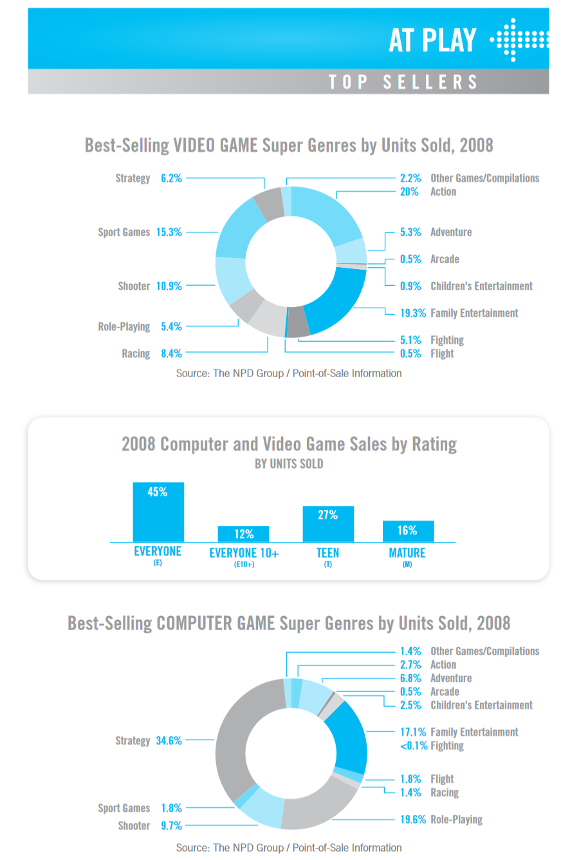
A History of Genres
Genres are a hierarchy.
In the Entertainment Software Association’s 2009 report (here) they identified the Super Genres
We can subdivide the genres further
Sports games can be sub-divided into the type of sport depicted.
Shooter games can be ones that utilise speed (FPS, On-Rails) or those that prefer to emphasise more realistic gameplay and historically accurate weapons with limited ammo.

Slide 7
Design Considerations
As gamers we’re familiar with different game genres, but we’re going to look deeper into the design considerations and mechanics of some popular types, such as:
Puzzle
Platform
Action/ Shoot-em up/ First-Person-Shooters
Strategy
Multiplayer
RPGs

Slide 8
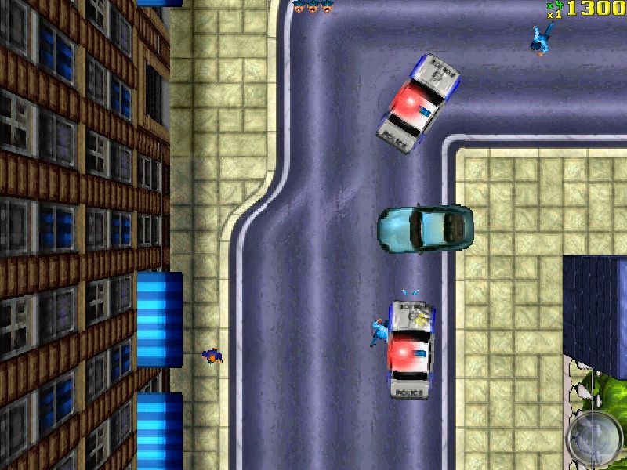
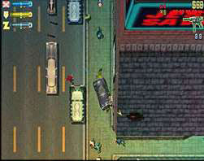
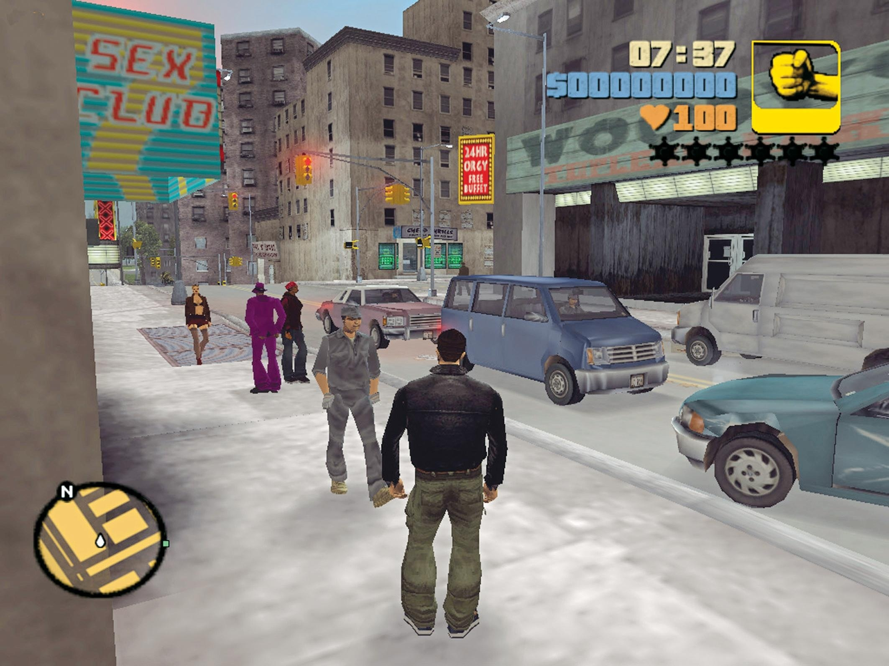
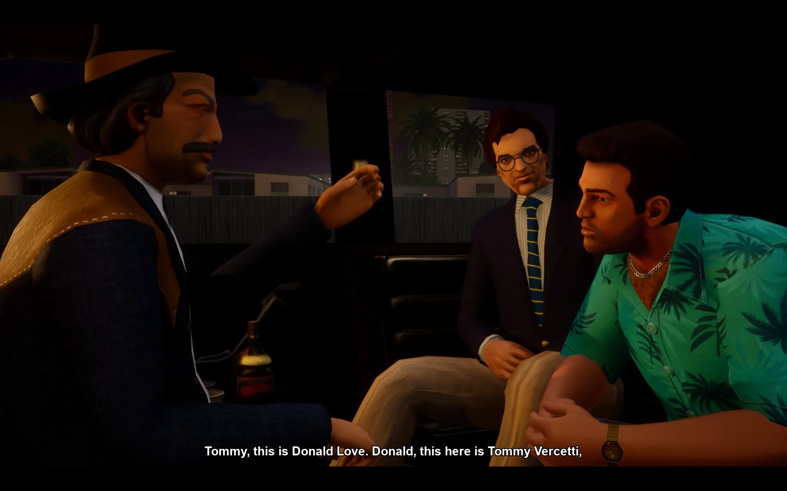
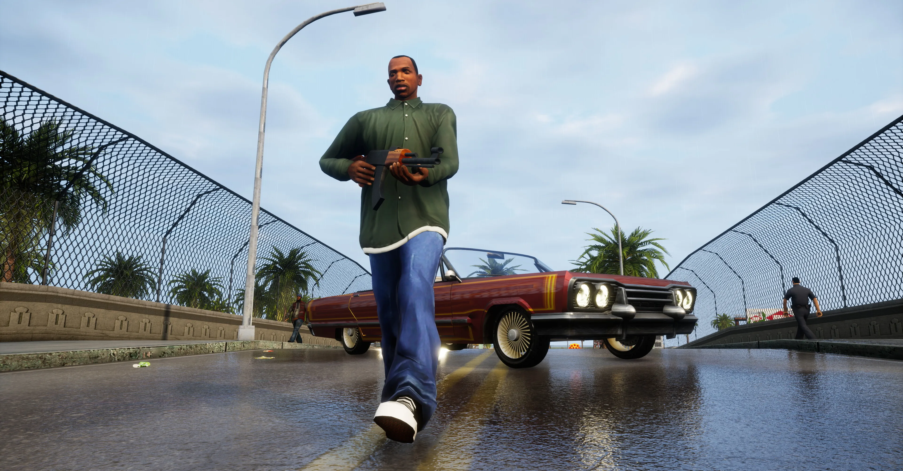
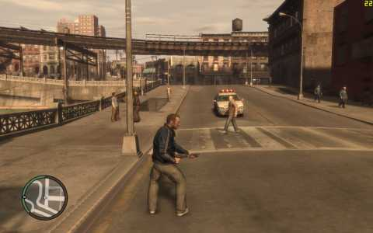
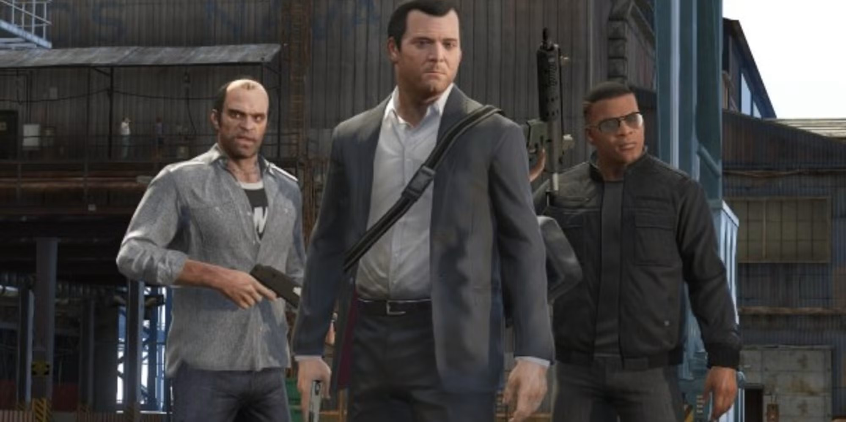
Where have I seen that before?
When genres collide!
According to Crawford (1982), early games were already starting to experiment with mixing genres. He noted that Donkey Kong was ‘vaguely like a race game with intelligent obstacles’ (note: ‘Platformer’ was not a genre included in his taxonomy).
So, what about Grand Theft Auto?
Its genre is Action-Adventure, although the main theme of the game is based around vehicles. The vehicles handle differently depending on their make and model, but it’s not a driving simulator. As the series moved from top-down 2D into 3D with GTA 3, the gameplay began to evolve more into an Action-Adventure with cars.
GTA San Andreas added more RPG-like elements, such as the need to exercise and eat healthy in order to maintain your fitness and stamina.
GTA V/ GTA Online added mini games such as Golf, Tennis, Arcade Machines, and the ability to go to the cinema or watch TV within the game.
GTA: 1, 2, 3, Vice City, San Andreas, 4, and 5 © DMA/ Rockstar North

Slide 9
Where have I seen that before?
GTA V/ Online is not the only game to merge different genres by any means, but the scale and scope of the game make it a good case study.
RPG Elements
Stealth
Casual Games
Action Adventure
Racing
First Person Shooter
GTA 5 © Rockstar North

Slide 10
Anatomy of a Puzzle
Many games contain puzzles or are puzzle-based.
The Puzzle follows a basic structure:
Problem
Outline of the problem and the initial conditions of the puzzle.
Rules
The rules and processes the player goes through to move from the problem to achieve the solution
Solution
The final state where the puzzle is considered complete or solved.
In addition, puzzles also have:
Props
Things you interact with (switches, floor pads, numbers in Sudoku)
Background and UI
Define the theme – if it is a puzzle in a game, what is the lore-friendly reason for it and how is it implemented?

Slide 11
Puzzle Games vs. Puzzles IN Games
Those points (Problem, Rules, Solution) can apply to any game type and provide a useful framework to model anything from a simple puzzle to game-spanning quests.
We do need to differentiate between:
Puzzles as games in their own right
Puzzles in games that form part of a larger whole
If your concepts presents a specific, focused challenge to the player then it’s likely you’re considering a stand-alone puzzle game.
NOTE – The Room series is an interesting example of a stand-alone puzzle game with puzzles within puzzles.

Slide 12
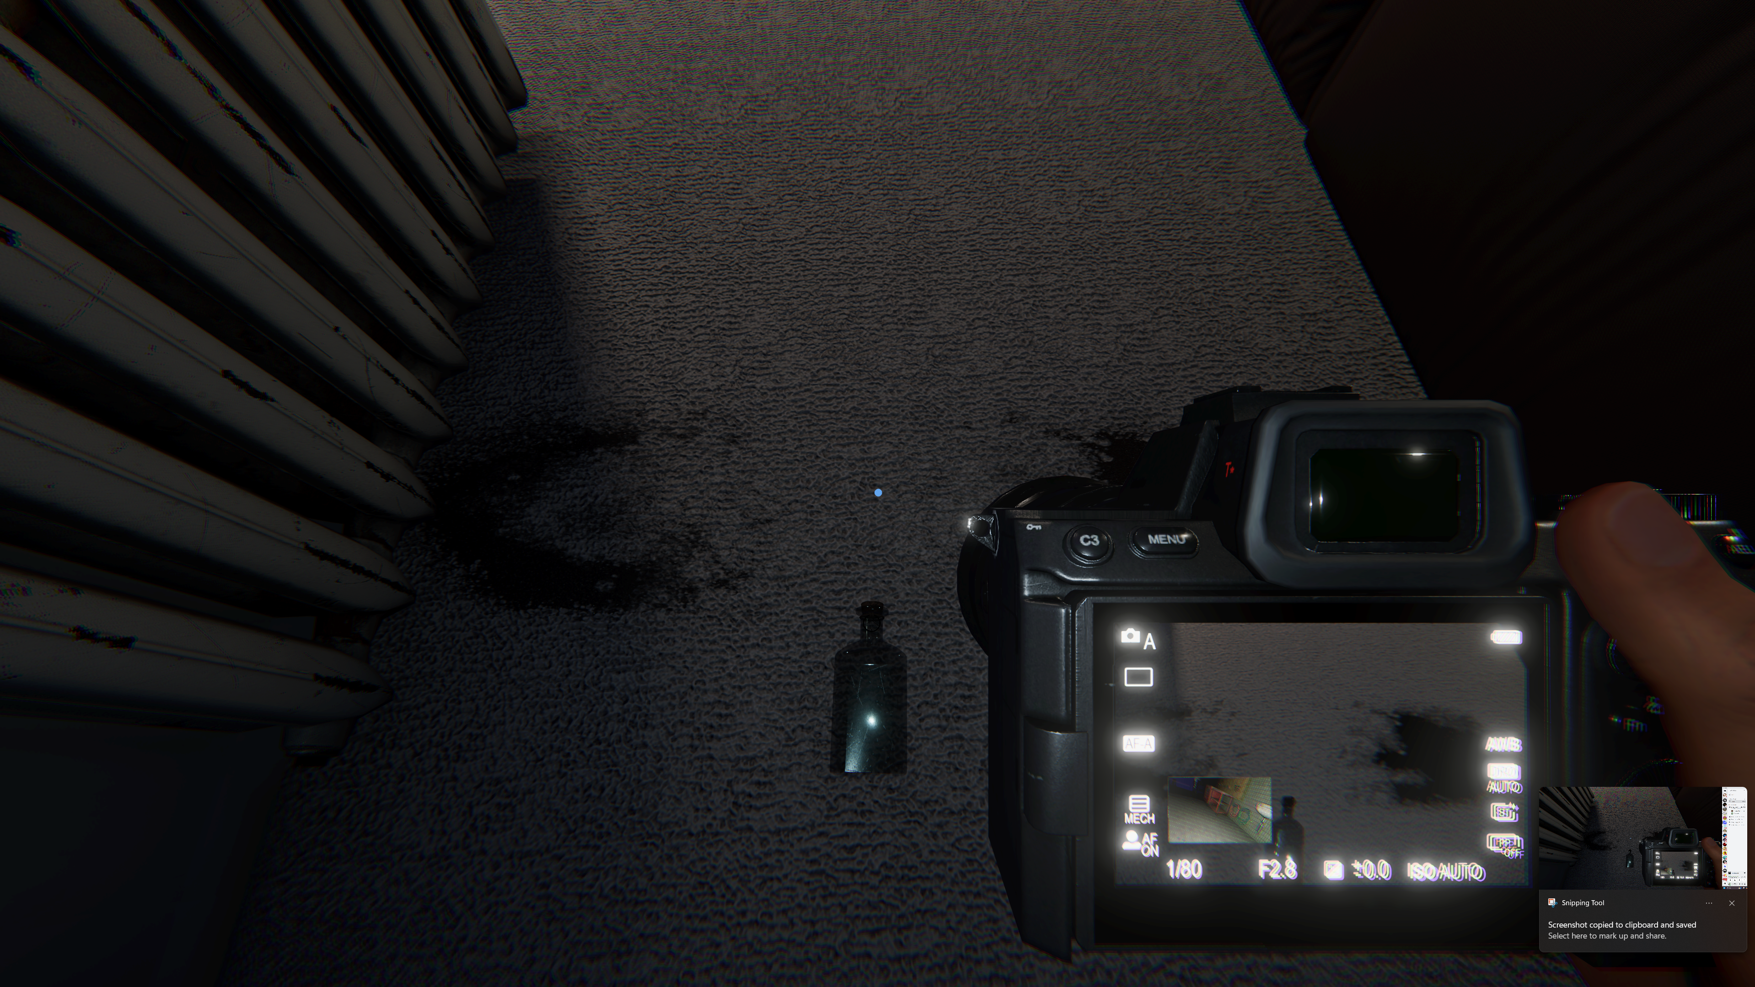
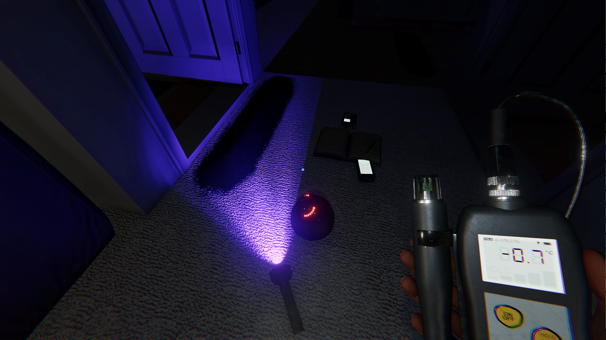
Puzzle Games – Phasmophbia
Made by Kinetic Games in 2020, Phasmophobia started a sub-genre of horror games based around ghost hunting and identification. The whole game is a puzzle, where the investigator(s) utilize a number of tools (temp gun, EMF reader, ultraviolet light) to search for clues in order to correctly identify the ghost, in exchange for cash and experience points. There are a set number of locations in the game and a random chance of getting any one of twenty ghost types, each with their own traits and behaviours, that can lead to a wide variety of scenarios and tactics being employed.

Slide 13
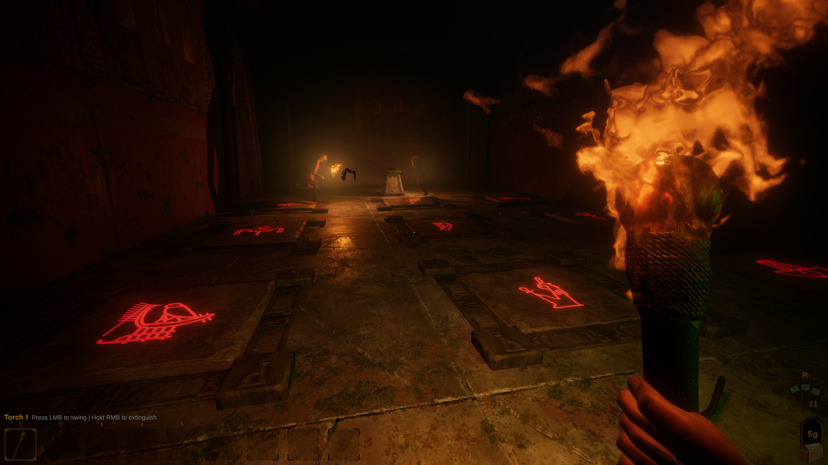
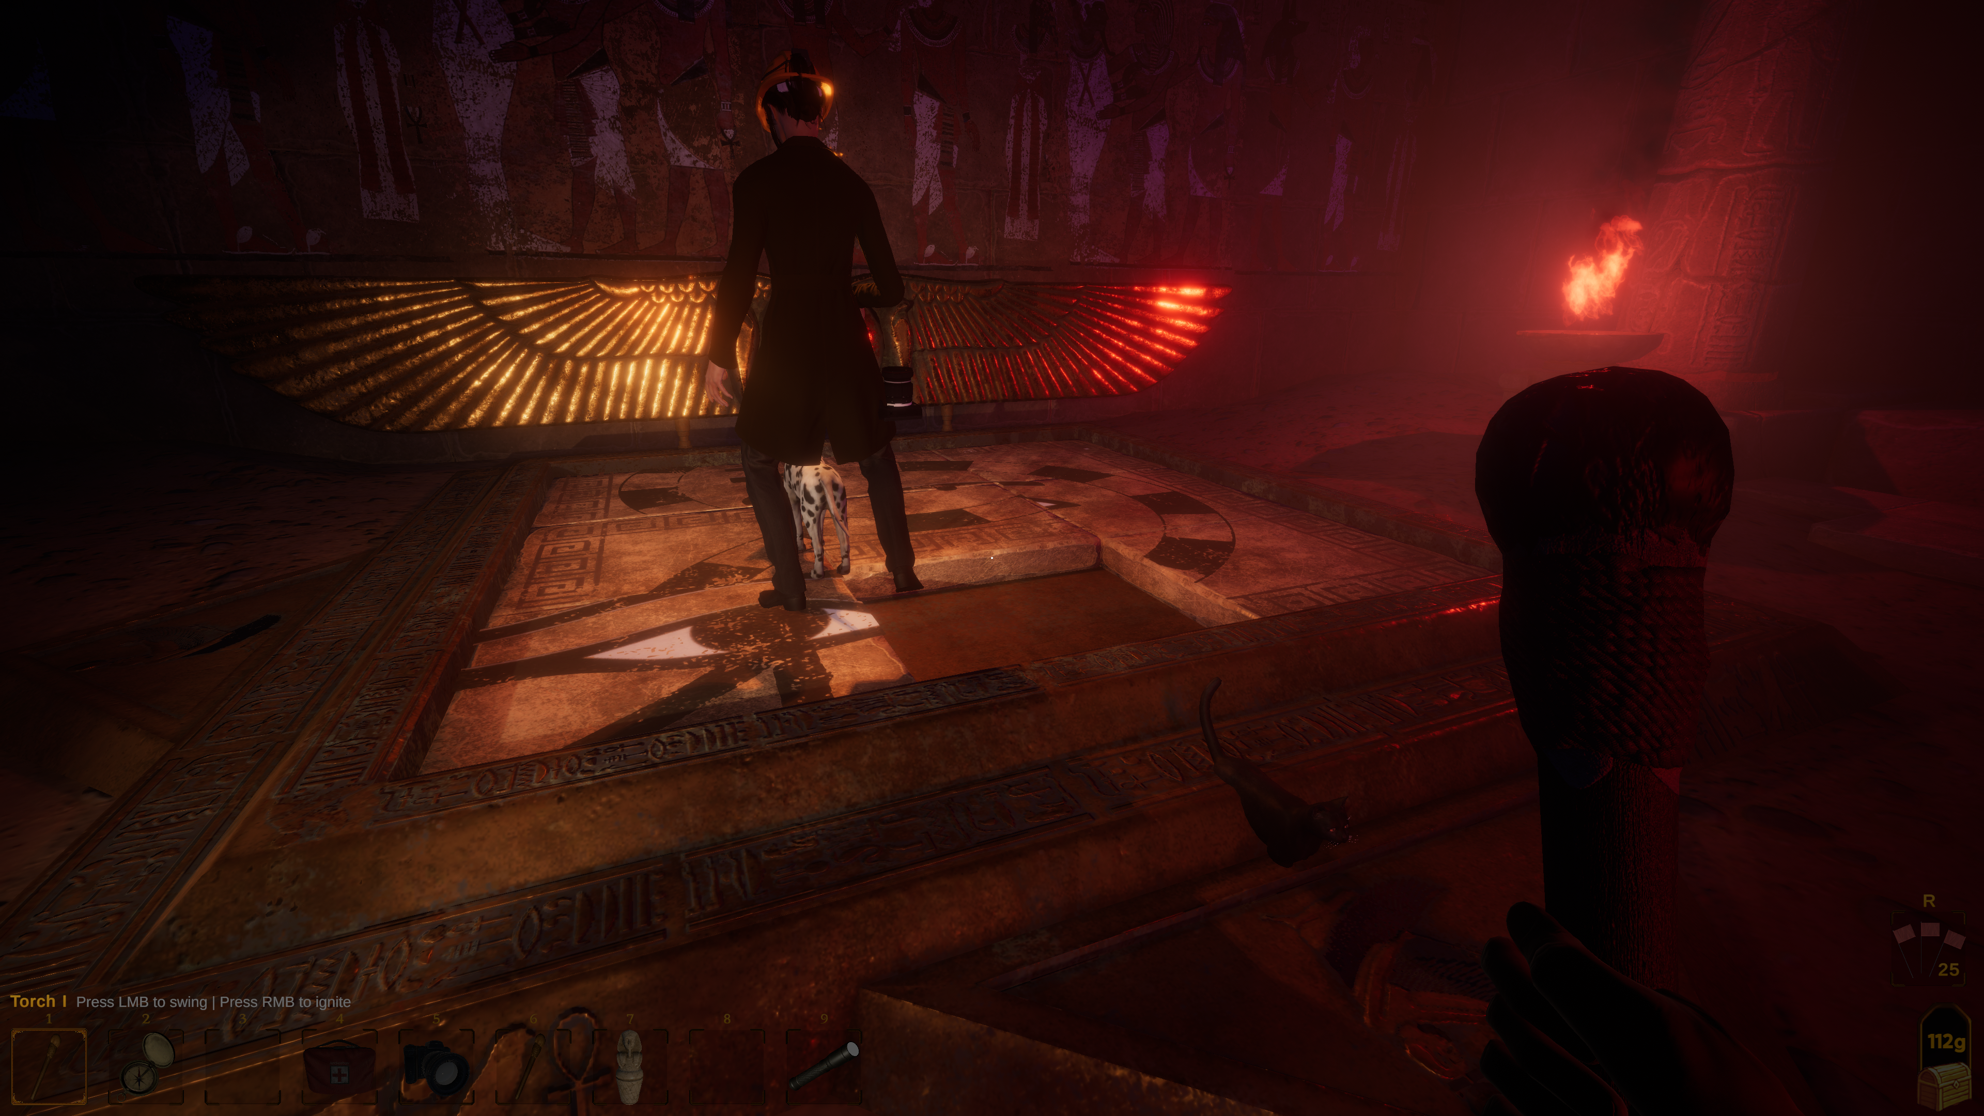
Puzzle Games - Forewarned
Made by Dreambyte Games in 2021, Forewarned is very much in the same genre of horror as Phasmophobia; but rather than exploring suburban locations, you are an archaeologist exploring tombs in Egypt. Using tools provided, you must identify the Mejai (ghost). After you have successfully done this, you then have the option to banish them through a ritual. Forewarned uses more recognisable puzzles within the structure of the gameplay of solving a puzzle.
Puzzle Game meets Puzzle In Games.

Slide 14
Puzzle Games vs. Puzzles in Games
When designing challenges and puzzles that are a part of a larger game, the designer needs to take into account the following considerations:
Puzzles in games should be a temporary hinderance to the player and should be focused, with clear descriptions of the problem and what the outcomes are (the solution). Sub-quests in RPGs should have a clear statement of the problem (the quest) and what is needed to complete it. If your puzzle becomes the focus of attention at the expense of the larger game, then perhaps it should be a stand-alone puzzle game.
Puzzles should fit the theme and world of the larger game. Forewarned uses classic puzzle designs with an ancient Egyptian theme; also drawing on the Indiana Jones-esque idea of trap-laden tombs. The puzzles should exist for a reason – A puzzle to unlock a door to escape a dungeon makes more sense than randomly completing a jigsaw on the way out.

Slide 15
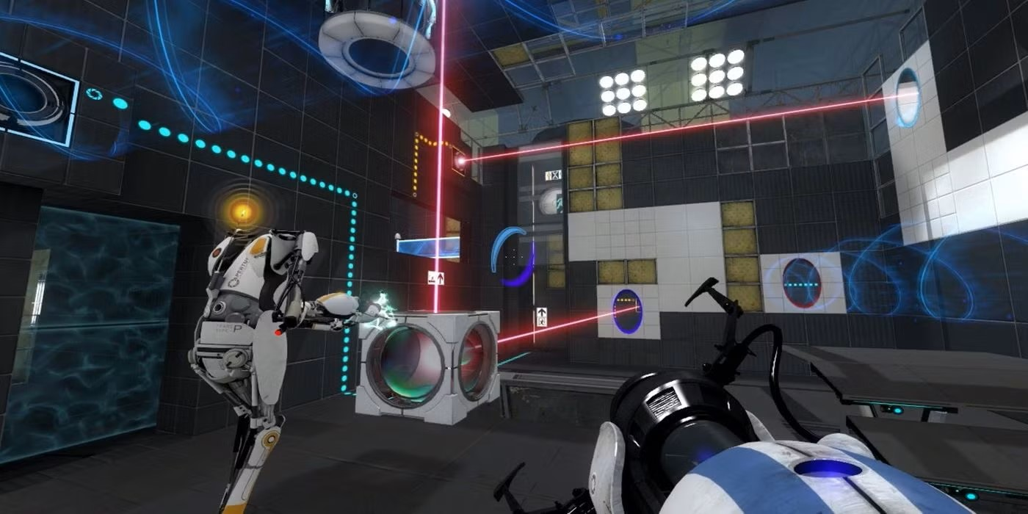
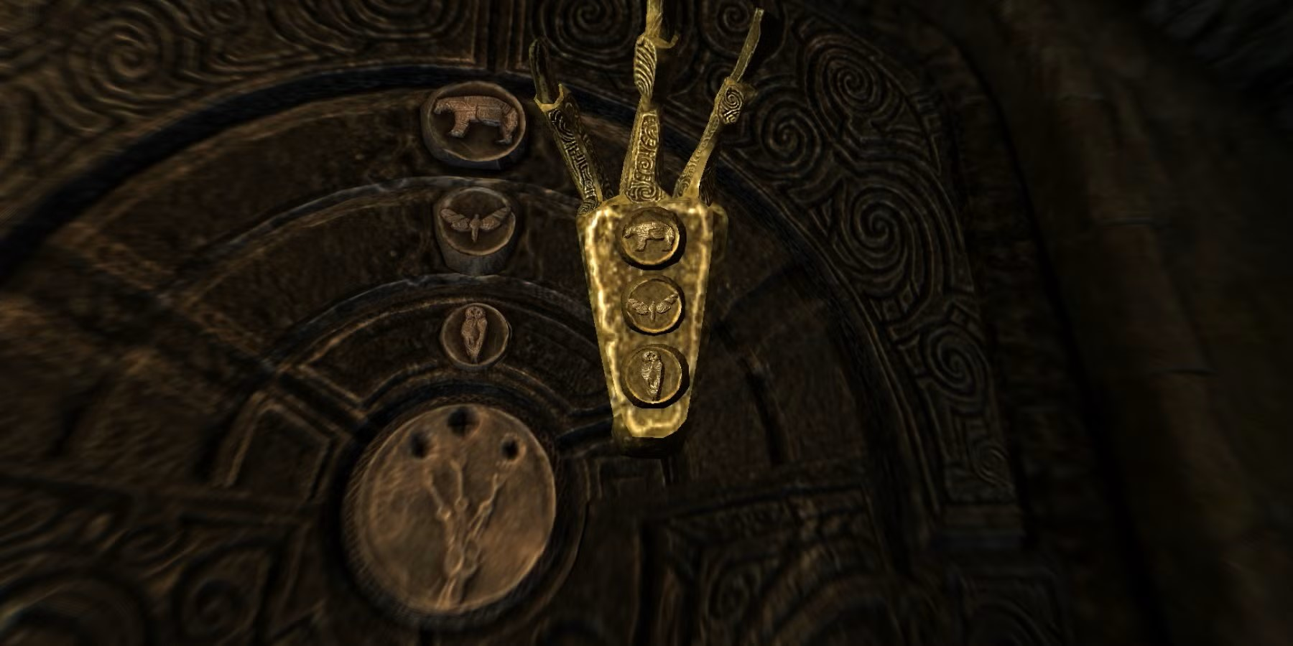
Puzzle Games vs. Puzzles in Games
Puzzles in games should be appropriately challenging. Keep the early puzzles simple while your players are still familiarising themselves with the mechanics and rules of your game world. Portal does this by slowly building up the complexity of the puzzles and increasing the size of the puzzle rooms as players progress.
Props/Objects needed to solve the puzzles should be in suitable locations i.e. where the player won’t miss them! In the Bleakfalls Barrow Quest in Skyrim, the player meets an NPC who has the key (the golden claw) inside the barrow. The game design makes it impossible for the player miss out on the claw needed to open the final door. The claw even has the solution to the door puzzle engraved on it.
Portal © Valve Corporation 2007
Be mindful of cultural and language considerations when you are designing your puzzles.
Elder Scrolls V: Skyrim © Bethesda Softworks 2011

Slide 16
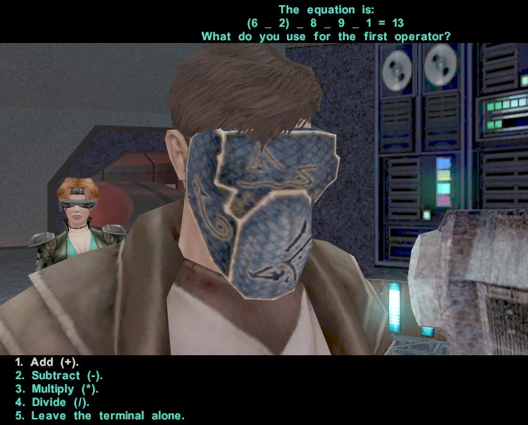
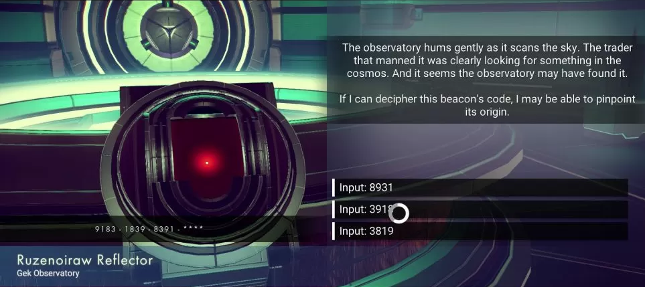
Puzzle Games vs. Puzzles in Games
Puzzle games fall into several different categories, such as:
Word based – Crossword, Word Searches.
Image based – Sliding puzzle, jigsaw.
Logic – Sudoku, maths/ numbers.
Memory – Trivial Pursuit, pattern matching
Dexterity – Tetris, button-combo
Hybrid - Hangman
Knights of the Old Republic 2: The Sith Lords © LucasArts/ Obsidian 2004
No Man’s Sky © Hello Games 2016

Slide 17
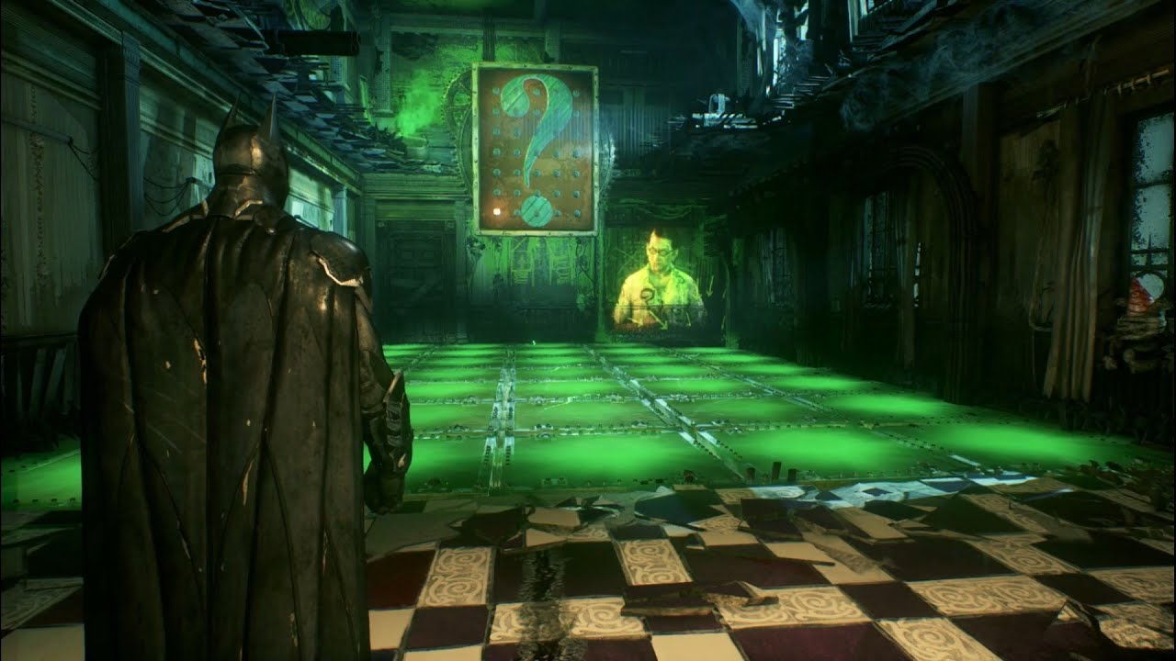
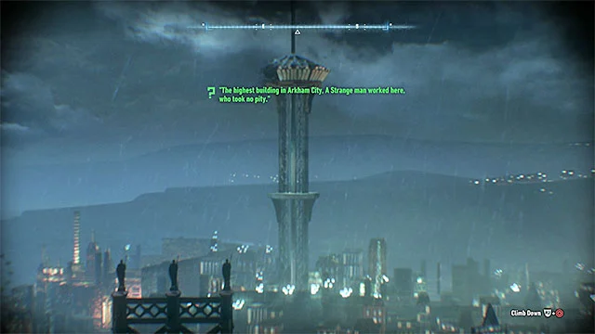
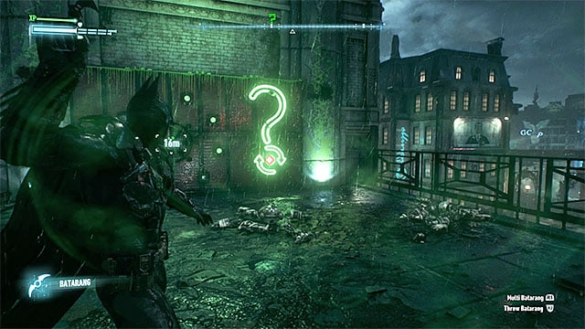
Puzzle Games vs. Puzzles in Games
The Batman Arkham series by Rocksteady Games, through the character of The Riddler, feature many variations on these puzzle types. There are riddles that take the player to different parts of the map, brainteasers, logic puzzles, puzzles based around skill and dexterity.
Once there is an understanding of how a puzzle works, it’s possible to put a unique spin on it.
Batman: Arkham Knight © Rocksteady Studios 2015

Slide 18








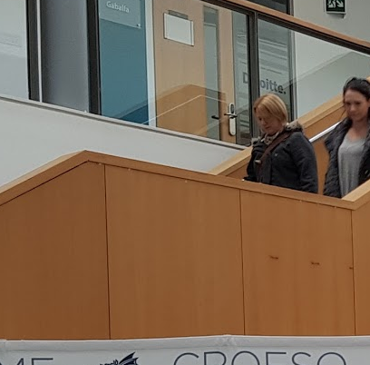






Examples
Sliding Puzzle – Image-based
Problem:
An image is split into an (nxn) grid of squares with the positions randomised and a square removed.
Rules:
1) The player can select any tile that is ‘4 connected’ to the empty tile.
2) The player slides the selected tile along with any immediate tiles to the empty space. The location of the chosen tile is now the new empty slot.
Solution:
The image tiles are arranged so that each portion of the tile is placed correctly within the image as a whole.

Slide 19
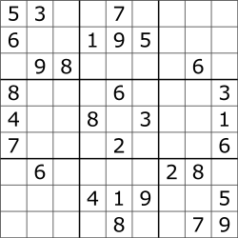
Examples
Sudoku – Logic-based game.
Problem:
A 9x9 array of squares (also a 3x3 array of 3x3 square blocks) is provided. Some squares are populated with numbers, where the rest are blank. The numbers are not random but set so the player can reach the solution.
Rules:
1) The player chooses a blank square to fill in with a number between 1 and 9.
2) The player cannot choose a square with a “given number”. These must remain immutable.
3) Step 1 is repeated until all squares are filled.
Solution:
All nine 3x3 blocks contain 9 unique, non-repeating numbers within the range [1, 9].
All nine 9x1 rows contain 9 unique, non-repeating numbers in the range [1, 9].
All nine 1x9 columns contain 9 unique, non-repeating numbers in the range [1, 9].

Slide 20
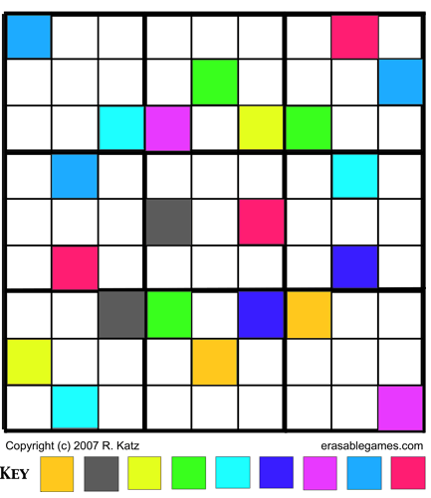
Props
We looked at the anatomy of a puzzle earlier and mentioned props.
The elements manipulated in a puzzle game are props – the visual elements with that player interacts with.
The props can be related to the theme of the game, which is important when integrating the puzzle into a larger game (the sliding tile puzzle in Forewarned).
This introduces a level of abstraction – we can swap out the props whilst retaining the underlying puzzle (problem, rules, solution). For example, Sudoku can be reworked to use 9 unique colours rather than numbers.

Slide 21
Randomisation and Difficulty Scaling
Randomisation can be a useful mechanic to introduce some variability and lend to the replay value.
These can be accomplished by randomising:
The starting conditions of the game, so every play is different.
Elements. New things can be randomly inserted to vary the play and playstyle.
Consideration would need to be given as to how this is done. Too much randomisation may unbalance the flow of the game. Make sure you know what needs to be kept constant/ consistent to keep the game playable.
Example – Tetris has a random starting prop, but there are only a few different shapes available. Regardless of which piece comes first, it will be playable with any that follow.
Sudoku scales its difficulty by removing “given numbers” from the board and leaving more blanks for the player. Crosswords rely on the difficulty of the clues provided, such as cryptic crosswords.

Slide 22
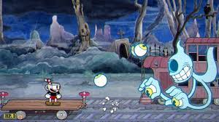
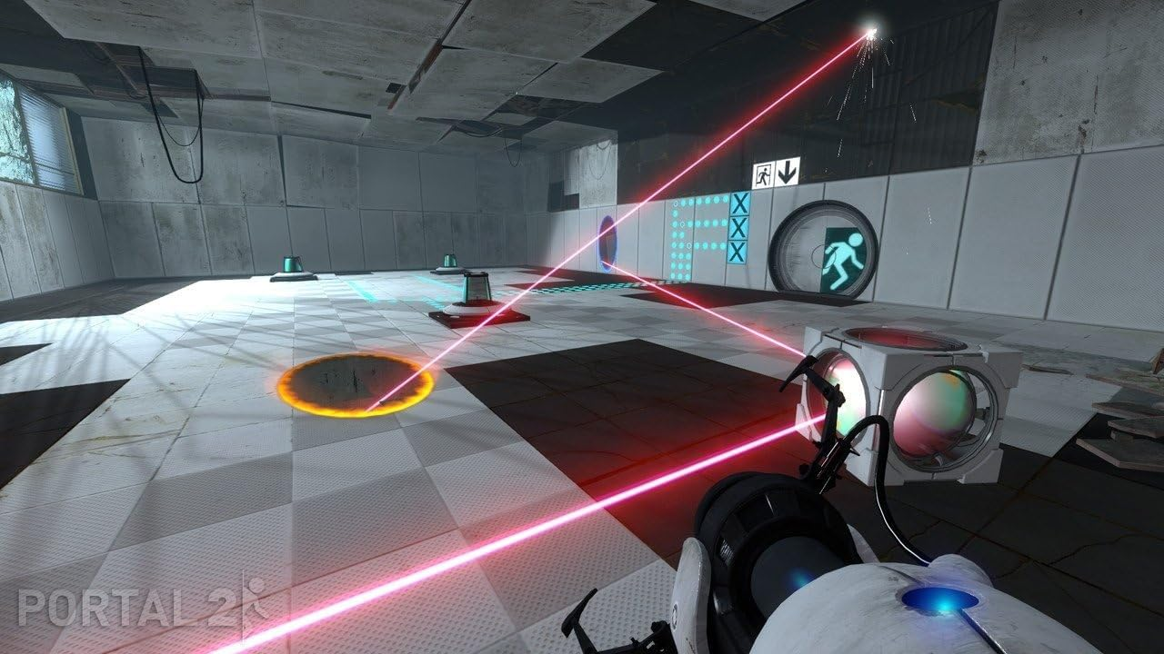
Platform Games/ Platformers
Sub-Genres of Platformer:
Run-and-Gun – A hybrid of platform and shoot-em-up. The focus is on attacking rather than problem solving and puzzles.
Contra
Cuphead
Commando
Puzzle Platformers – Puzzle is integral to gameplay, in addition to navigating a platform-based environment. Games like Lemmings and Doki Doki Penguin Land involve guiding/shepherding characters to points on the map in order to save them. Portal uses physics and platform mechanics to solve puzzles. Braid use time manipulation as a means to solve puzzles.
The Lost Vikings
Portal 2
Fez
Cuphead ©Studio MDHR
Portal 2 ©Valve Studios

Slide 23
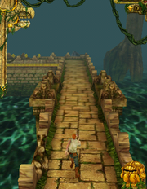
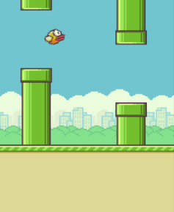
Platform Games/ Platformers
Types of platformer:
Infinite/Endless Runner – Popular on mobile devices given the limited controls. Players navigate a (typically) procedurally generated environment.
Temple Run
Flappy Bird
Pitfall!
Platform Adventure – Mixes free-roam with platforms, which means you can explore the world in any direction. Can be extended to include RPG elements.
Legend of Zelda
Hollow Knight
Oddworld

Slide 24
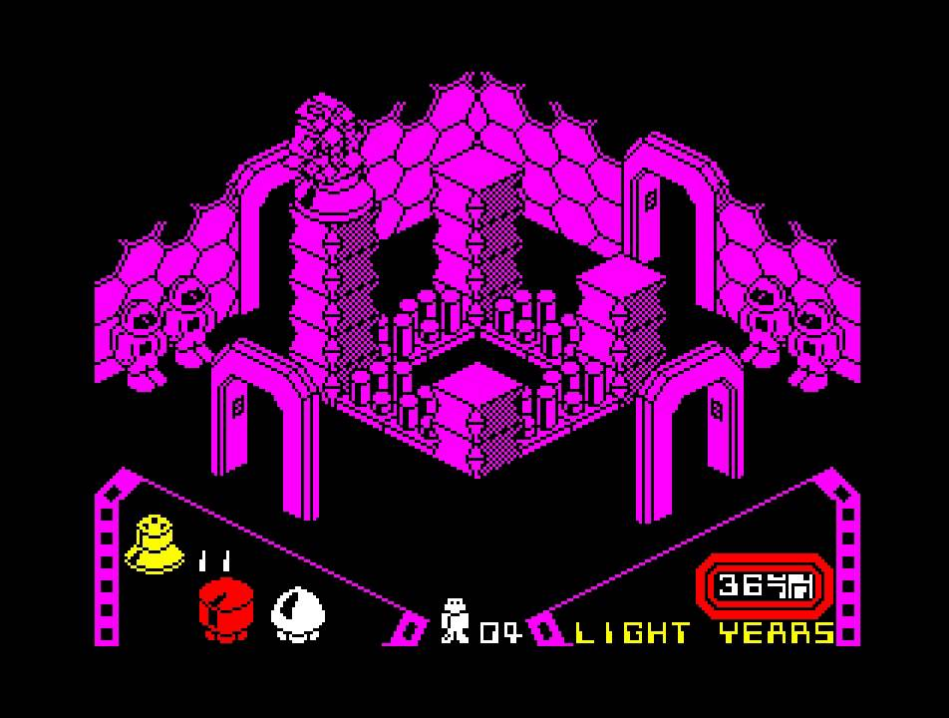
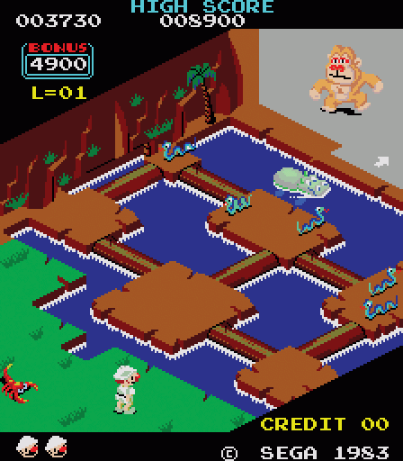
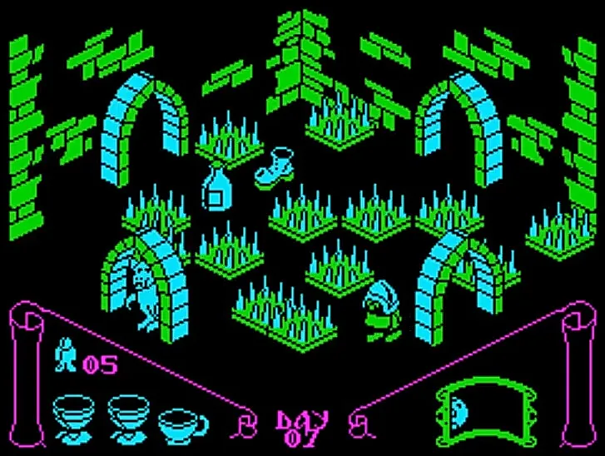
Platform Games/ Platformers
Sub-Genres of Platformer:
Isometric Platformers – Platform mechanics and gameplay shift into 3D. Early games in this sub-genre were purely sprite-based, but advancements in 3D hardware and capabilities make this more of a design choice than a technical necessity.
Congo Bongo
Knightlore
Alien8
Alien8 ©Ultimate Play The Game 1985
Congo Bongo ©Sega 1983
Knightlore ©Ultimate Play The Game 1984

Slide 25
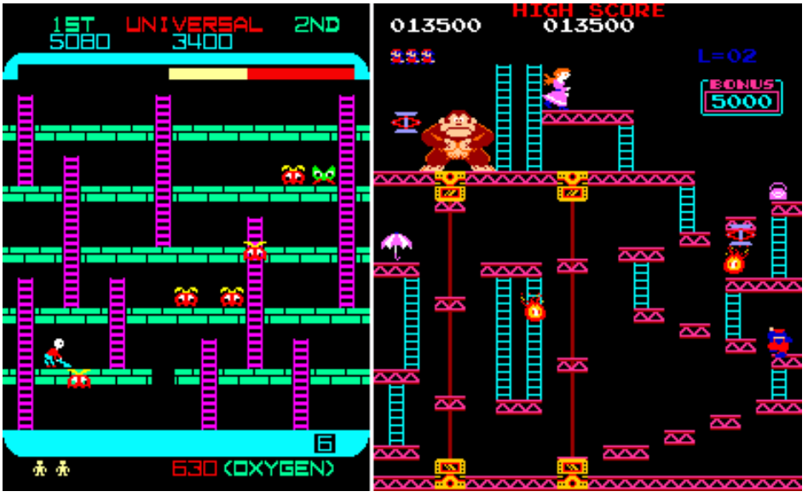
Platform Games/ Platformers
Nintendo’s Donkey Kong (Miyamoto, 1981) is often credited as being the first platformer. Alt (2023) suggests that the credit actually belongs to Space Panic (Universal, 1980), which does bare a strong resemblance to Donkey Kong.
Both games utilise platforms, ladders, and obstacles (aliens and barrels respectively) that will kill the player on contact.
In both games, the player needs to avoid the obstacles and climb the ladder to the top of the screen to progress to the next screen/level. Being confined to a single screen was due to technical limitation of the hardware.
However, the real difference is the use of gravity in the game. In Donkey Kong Jumpman (before his name was changed to Mario) jumps over the barrels, whereas in Space Panic our player digs holes in the platforms to trap the aliens and then fills them up, causing the alien to fall.
Space Panic (1980) ©Universal
Donkey Kong (1981) ©Nintendo
It has been argued that Donkey Kong had a much broader appeal and popularity than Space Panic, and that subsequent platformers probably owe more to Donkey Kong for establishing the expectations of the genre (Retrogame Deconstruction Zone, 2020).

Slide 26
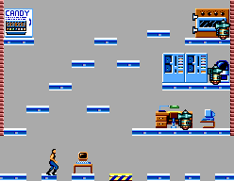
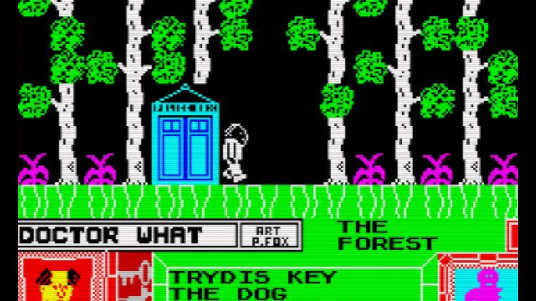
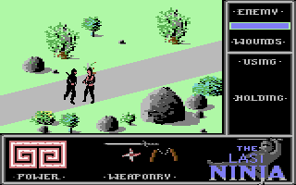
Platform Games/ Platformers
Platform games changed as technology expanded, enabling the player to go beyond the confines of a single screen.
Flip-Screen – When reaching the extreme left or right of the screen, the next screen is drawn and is designed to be a continuation of the same space, with the player being positioned on the opposite side to where they left the previous screen. Enemy NPCs were confined to their own screen.
Sierra’s Quest for Glory series allowed enemy NPCs to follow the player screen to screen.
Flip-Screen was more popular on home computers, which were generally not technically capable of handle scrolling.
Impossible Mission ©Epyx 1984
Doctor What! ©CRC 1985
Aside - Although more an Action/Adventure title than a platformer, The Last Ninja games were very creative with their flip-screen design. The next screen is drawn/generated in front of the player from back to front, with trees and props generated last.
The Last Ninja ©System 3 1987

Slide 27
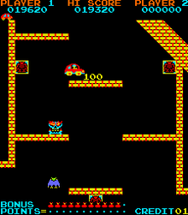
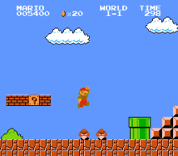
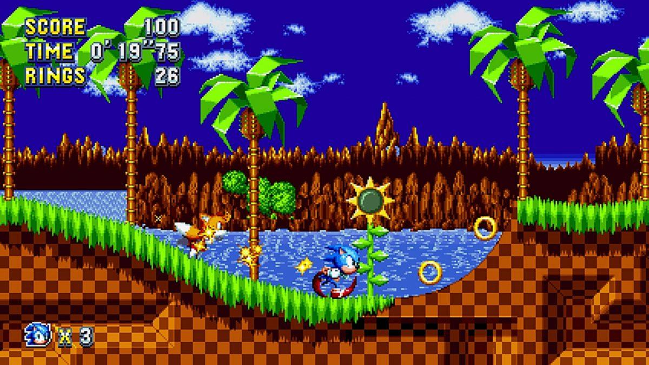
Platform Games/ Platformers
Scrolling Platform Games
Jump Bug in 1983 was the first platformer to introduce scrolling. Super Mario Bros in 1985 was based on this.
Jump Bug also established the foundation upon which many popular platform games went on to follow – a 2D world populated by 2D platforms which the player needed to navigate by jumping and/ or climbing.
Going into the 90s –
The 16-bit consoles began to lift some of the previous generation’s hardware limitations.
Sega’s 1991 hit Sonic the Hedgehog took the elements that games such as Super Mario Bros had introduced but added a main character that moved at high speed. The levels were designed to support this with a smooth flow and ramps to enable high jumps.
Platform games of this era also started to use parallax scrolling, giving the illusion of depth by having the background move as a different speed to the foreground.
Jump Bug ©ADK Corporation 1983
Super Mario Bros ©Nintendo 1985
Sonic the Hedgehog ©Sega 1991

Slide 28
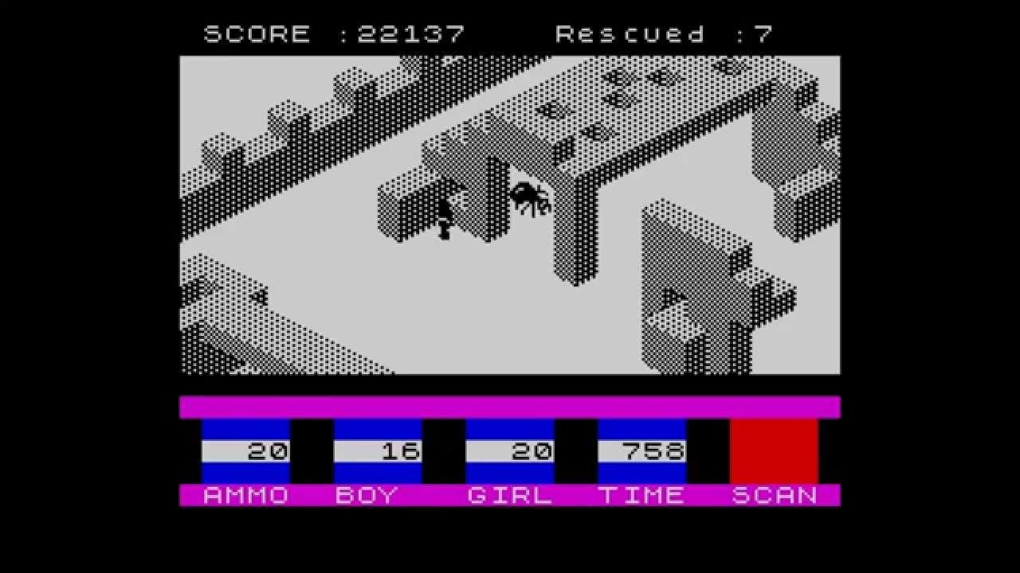
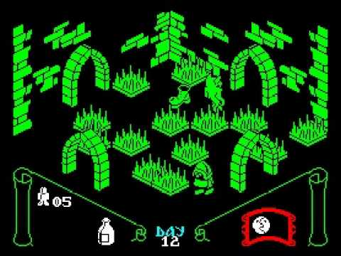
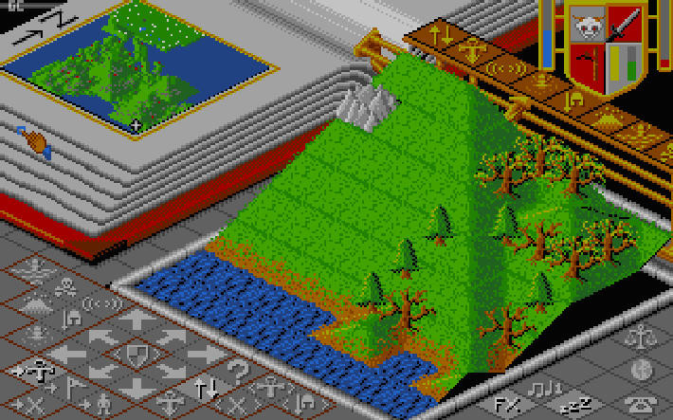
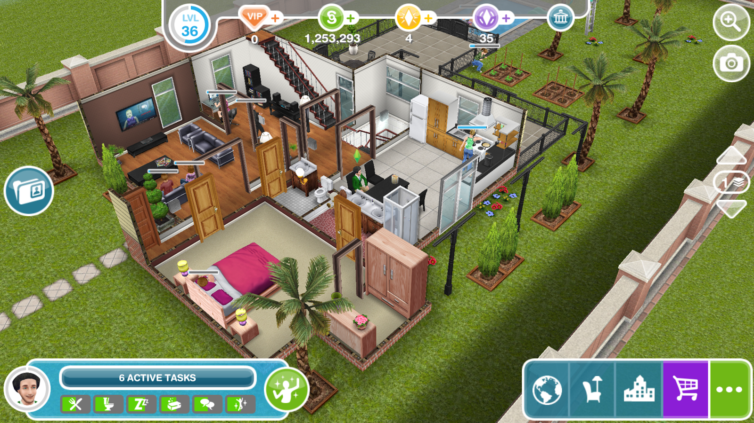
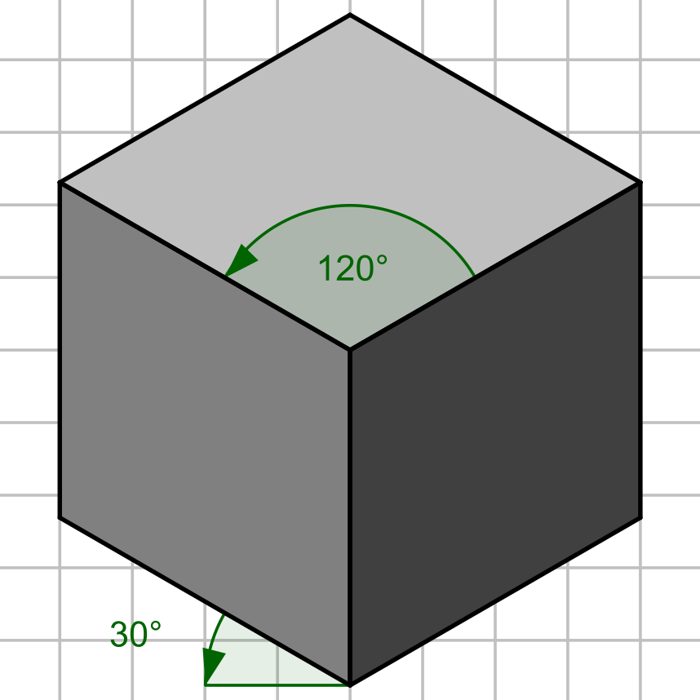
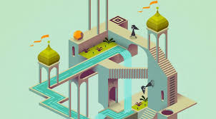
Platformers go 3D (nearly)!
Not all platformers are side-on 2D. Some early platform games were isometric-based, where the player view-point is positioned above and at an angle.
Some notable isometric platform games:
Marble Madness
Knightlore
Head Over Heels
Ant Attack
The term isometric derives from the angle that objects are being viewed from.
Greek – Isometria:
Iso = Equal
Metric = Measuring

Slide 29
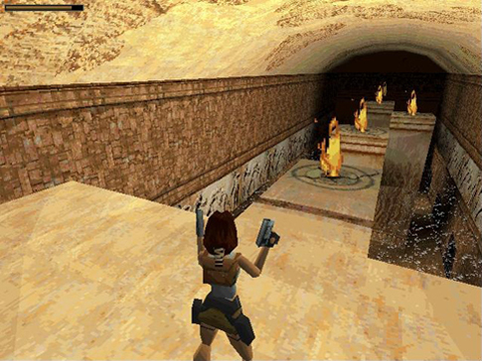
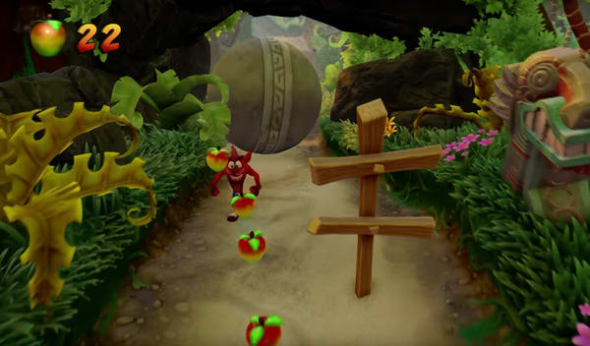
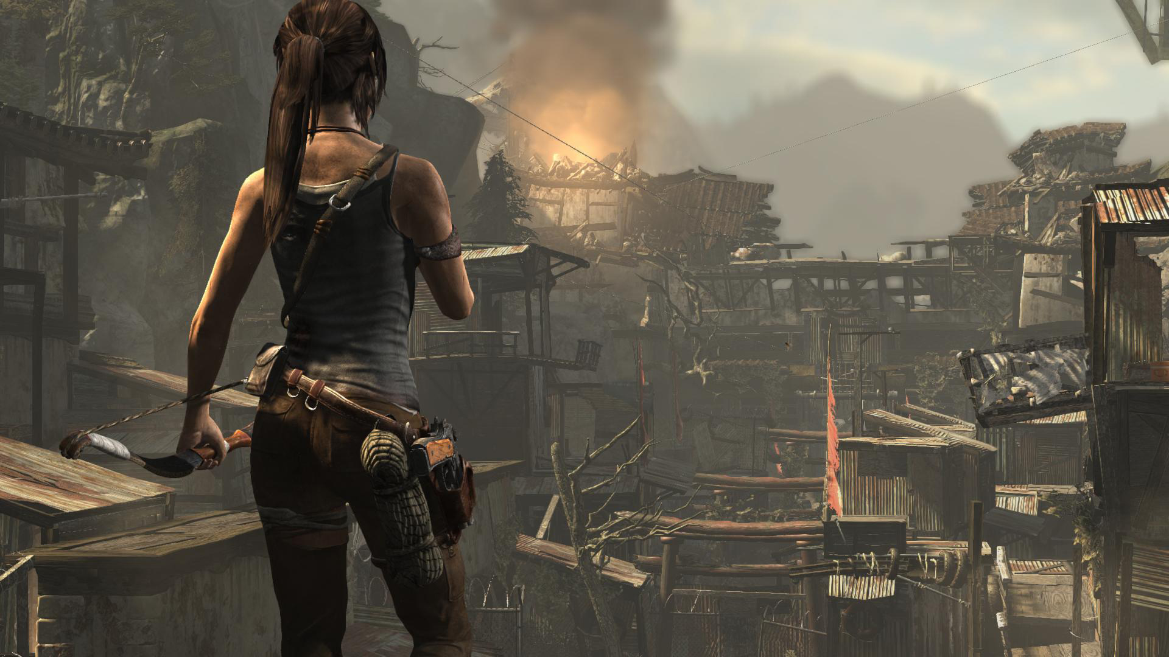
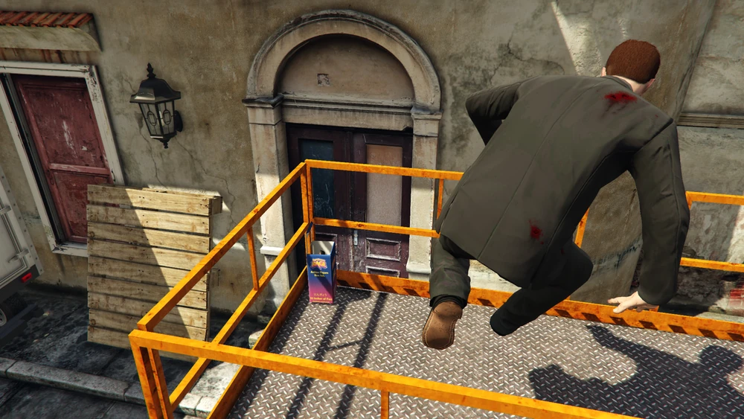
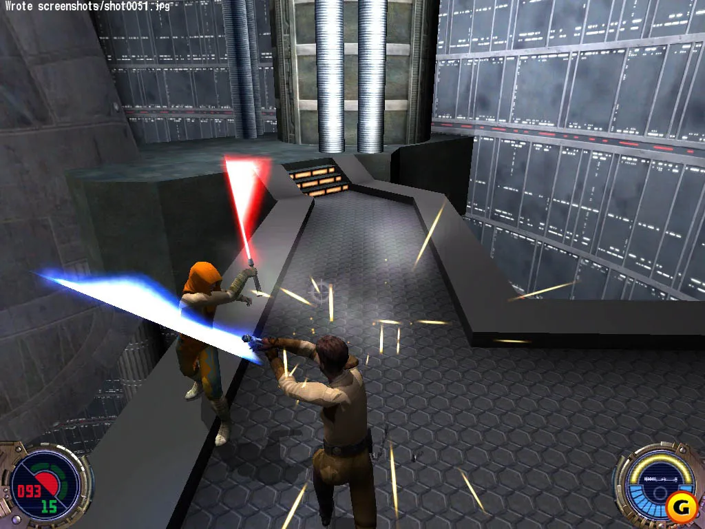
Platformers go 3D (actually!)
Platform game mechanics have now evolved beyond being a distinct genre. Fully immersive 3D environments have opened up the potential for adding platform mechanics into other genres, such as Action/Adventure.
The Thief and Hitman series’ make use of platform mechanics to enable the player to access buildings in different ways.
The parkour mechanic in the Assassin’s Creed series.
The GTA Online Mission “Gerald’s Last Play: Go Figure” has the player climbing onto various ledges and rooftops to collect action figures.

Slide 30
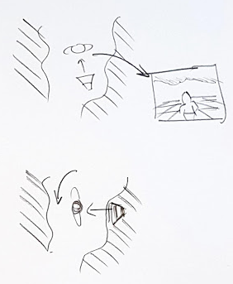
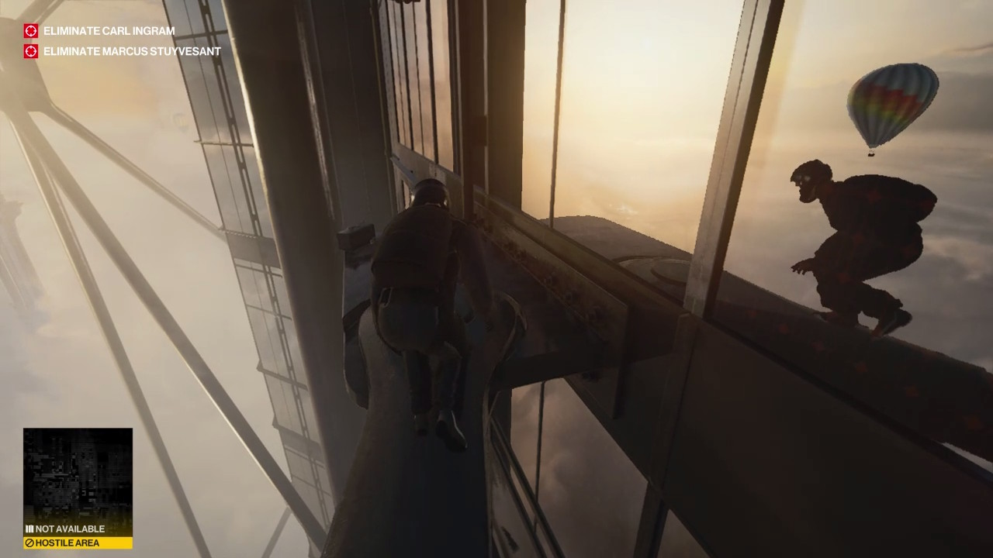
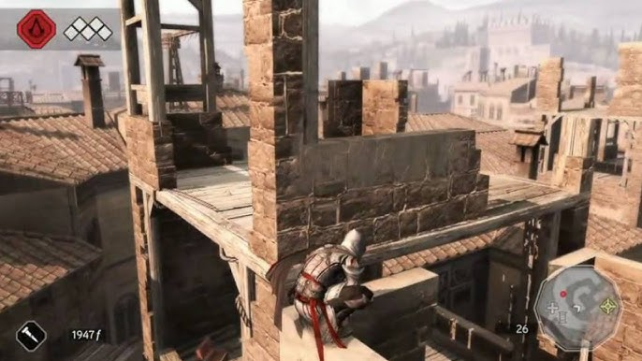
Platformers go 3D (actually!)
3D Platfomers present many challenges to the developer, not least of which is how to manage the camera.
First-Person Camera – Affords an unobstructed view of the environment (at eye-level) but can become much harder to gauge distances between jumps.
Third-Person Camera – Positioned around the Player Avatar, generally behind and elevated, and can be moved independent of the Player position. This can make gauging jumps and scouting ahead much easier, but consideration needs to be given as to how the camera behaves when intersecting buildings and scenery.
Camera located behind the player
As the player rotates, if the camera’s position remains fixed – relative to the player, it might intersect the scenery).

Slide 31


2D Mechanics in a 3D World
Some platformers have a 3D environment but are restricted to 2D-style gameplay and mechanics.
Pandemonium
Crash Bandicoot
Unity and Unreal Engine can both be used to make a 2D-style game with 3D assets. Both game engines ‘cheat’ 2D, as they both still utilise the Z-Axis.
Pandemonium ©Toys for Bob/Eidos 1996
Crash Bandicoot ©Naughty Dog/Toys for Bob 1996

Slide 32
Core Mechanics
There is a common set of core mechanics on which gameplay is based:
Walking/ Running
Example: “The player navigates along a given platform, ledge, or the ground by moving left and right. It is also possible to sprint left and right to cover greater distances and allow the player to trigger longer jumps where necessary” – This describes basic walking/ running mechanics for a 2D platformer.
Jumping
Example: “The player can jump directly up by a set distance. Gravity slows the player until they stop jumping and start to fall. When jumping while walking, the player can move laterally during the jump. If sprinting, the lateral movement is much larger which means that the player can cover a greater distance”.
Other Key Mechanics (different games will have their own specific mechanics).
Ducking, Climbing, Sliding, Fire/ Attack, Defend, Interact.

Slide 33
State Modelling
When designing a game, and trying to establish the flow of the game, it can be useful to identify the different states a character will be in (walking, running, jumping, falling etc.) and how a character goes from one state to the next.
State-chart diagrams are typically found in the Technical Specification, but a more basic overview of the different states as done by the designer could aid in expressing the gameplay and flow of the game.
Standing
Fall off edge
Land
Stop moving [speed >= T]
Falling
Running
Jump pressed (enter lateral jump)
Land / Hit Ground too fast
Sliding
Move player
Standing
Jumping
Hit obstacle
Stop moving [speed < T]
Die
Comes to a stop
Jump pressed (enter vertical jump)
Actions / events that change states
Character states

Slide 34

Puzzles and Props – Level Design Considerations
We have looked at puzzles in games. Let’s look at some considerations and examples of how they are implemented in Platformers:
Dexterity
The most common type of challenge in the genre, testing the player’s skill at navigating the environment.
Games like Prince of Persia took an extreme approach to this idea, requiring pixel-perfect accuracy when timing jumps.
A design document might include illustrations about this requirement for the level designers and programmers.
At the start of the jump animation sequence the player’s foot position must be within 5 pixels of the platform edge.
Gaps are 50 or 60 pixels wide. For a 50-pixel gap, the player can jump and land on the target platform. For 60-pixel gaps, the player will grab the edge of the platform and require a subsequent climb action to get onto the target platform.

Slide 35


Puzzles and Props – Level Design Considerations
Logic
Logic in platform games can vary:
Finding keys to open specific doors
Collecting objects in order to complete a task
Using relevant game mechanics to manipulate the environment to achieve your goal.
Abe’s Oddysee (Oddworld Inhabitants) used mechanics (abilities) such as sneaking, talking, chanting and possessing enemies to solve puzzles and navigate through and escape Rapture Farms.
Physics
The increase in hardware capability has opened up more possibilities for different types of challenge, such as physics-based puzzles, where the player must use the environment and props/ objects within the environment to reach their goal.
Limbo (Playdead) is an excellent example of a physics-based puzzle-platform game, where objects served as hazards and in many cases had to be used cleverly to progress through the environment. This also uses dexterity and logic / problem solving elements mixed in with the physics.

Slide 36



Puzzles and Props – Level Design Considerations
Monument Valley (Ustwo Games) used Escher-esque environments to provide challenges to the player.
Perception/ Environment
Some games present visual challenges to the player, where a key aspect is to find ways through the level that are not immediately obvious.
This involves using logic in combination with exploration (the player needs to be allowed to explore freely)
Viewfinder (Sad Owl Studios) uses photographs taken by the player to form new pathways through the levels in order to reach the goal.

Slide 37

Flow Considerations
When designing a fast-paced platformer, the flow of the game needs to be carefully considered, as it impacts:
The design of the levels to support set-piece moves (Sonic the Hedgehog)
Introduce/ implement relevant mechanics to facilitate better flow:
Capcom’s Strider was renowned for fast-paced running, sliding, and 8-way movement which provided the player a greater degree of movement within the game environment.
Testing these types of mechanics, and ensuring that your level design supports them, is crucial.
Strider ©Capcom 1989

Slide 38
References / Resources
Adams, E. (2009) The Designer’s Notebook: Sorting out the Genre Muddle. Available at: https://web.archive.org/web/20141217155232/http://www.gamasutra.com/view/feature/4074/the_designers_notebook_sorting_.php [Accessed 2 November 2024]
Alt, E. (2023) A Brief History of the Platformer. Activision Blizzard. Available at: https://newsroom.activisionblizzard.com/p/a-brief-history-of-the-platformer [Accessed 2 November 2024]
Crawford, C. (1982) The Art of Computer Game Design. Chapter 3, p.23. Available at: https://www.digitpress.com/library/books/book_art_of_computer_game_design.pdf. [Accessed 2 November 2024]
• Moore, M. “Basics of Game Design” Chapter 9.
Miyamoto, S. (1981) Donkey Kong [Video Game] Nintendo.
Retrogame Deconstruction Zone (2020) What Was the First Platformer, Space Panic or Donkey Kong? [Online] Available at: https://www.retrogamedeconstructionzone.com/2020/07/what-was-first-platformer-space-panic.html [Accessed 2 November 2024]
Universal (1980) Space Panic [Video Game] Universal.

